Slide 1
SESSION 40
Vision-Language-Action Models
How robots go from seeing and hearing to doing
The models, training recipes and open problems behind today's generalist robot policies.
COMPUTER VISION & AI SERIES
THEORY SESSION
DURATION
Final session · Robotics & embodied AI
Concepts first, no coding today
60 minutes
Everything here is theory: the goal is to understand VLA models deeply enough to use, evaluate and discuss them.

Slide 2
ROADMAP
From pixels and words to motor commands
1
What a VLA model is, and why we need one
The gap between perceiving the world and acting in it.
2
How VLA models are built
Vision encoder, language backbone, fusion, and an action decoder.
3
How they connect vision, language and action
Tokens, continuous actions, chunking, closed-loop control.
4
How they are trained
Demonstrations, imitation learning, pretraining, fine-tuning, and RL.
5
The models that define the field
RT-1/2, OpenVLA, pi-0, GR00T N1, and how they compare.
6
Where this is going
Applications, hard open problems, and current research directions.
Session 40 · Vision-Language-Action Models

Slide 3
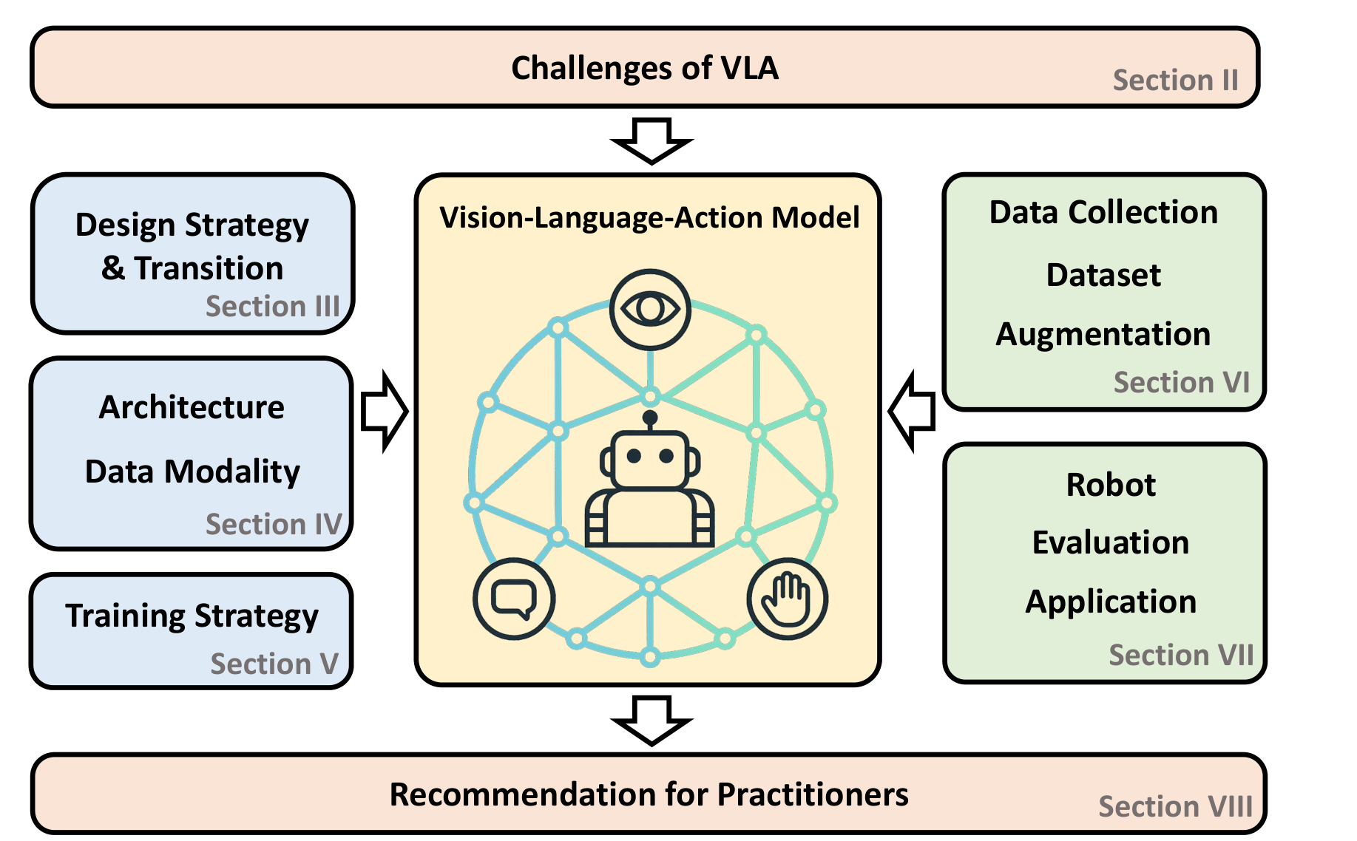
HOW THIS SESSION IS GROUNDED
Built on a 2025 IEEE Access review of the field
One survey, one shared vocabulary
This paper reviews VLA architectures, training strategies, datasets, robot platforms, evaluation and real deployments across the whole field. We follow its definitions and structure tonight so the terms you hear here match what you'll read in papers.
Why lean on a survey, not one paper
Any single VLA paper argues for its own design. A survey has to be honest about what's still unsettled: which action representation wins, how much data cross-embodiment transfer really needs, and what "safe" even means for a robot policy. That honesty is exactly what a first, practical introduction needs.
Kawaharazuka, Oh, Yamada, Posner & Zhu (2025), Vision-Language-Action Models for Robotics: A Review Towards Real-World Applications, IEEE Access, arXiv:2510.07077.
Session 40 · Vision-Language-Action Models

Slide 4
DEFINITION
A model that turns pixels and words into motor commands
Definition I.1 (Kawaharazuka et al., 2025)
“A Vision-Language-Action (VLA) model is a system that takes visual observations and natural language instructions as required inputs and may incorporate additional sensory modalities. It produces robot actions by directly generating control commands.”
Vision
Language
Action
What the robot currently sees: one or more camera streams, sometimes depth or point clouds.
What it's being asked to do: a free-form instruction, not a menu of preset commands.
What comes out: a control command the robot can execute right now, not a caption or a plan.
The line that matters
A system where a VLM only picks an index from a fixed set of pre-trained skills or motion primitives does not count as a VLA under this definition, however smart the picking is. A VLA has to generate the control command itself.
Session 40 · Vision-Language-Action Models

Slide 5
MOTIVATION
Because scripted robots break the moment the world changes
The classical answer
The cost of that answer
See a bolt: run a bolt detector. Plan a grasp: run a grasp planner tuned to that bolt. Move there: run a motion planner tuned to that arm. Every stage is hand-built for one task, one object set, one robot, one environment.
Change the object, the lighting, the table height, or the robot, and some stage silently stops matching its assumptions. Coverage grows one narrow module at a time, and nothing you build for task A transfers to task B.
THE VLA BET
Train one policy, end to end, on enough diverse vision-language-action data that it absorbs the pattern of “how instructions map to actions” rather than memorising one task. The same recipe that let language and vision models generalise from web-scale data is now being pointed at robots: fewer bespoke modules, more learned generalisation.
Session 40 · Vision-Language-Action Models

Slide 6
THE LINEAGE
Three generations, each one closer to acting
Computer Vision
Vision-Language Models
Vision-Language-Action
Label what's in the image.
Describe and reason about the image, in words.
Act on the image: produce a motor command.
ResNet, YOLO, ViT classification and detection
CLIP, GPT-4V, PaLI-X, Gemini
RT-2, OpenVLA, pi-0, GR00T N1
What carries over at each step
Vision brought convolutional and transformer backbones that turn pixels into features. Vision-language work added a shared embedding space where an image and a sentence can be compared directly. VLA reuses both, and simply adds one more output head: instead of stopping at a caption, the model keeps going until it has a number the robot's motors can use.
Session 40 · Vision-Language-Action Models

Slide 7
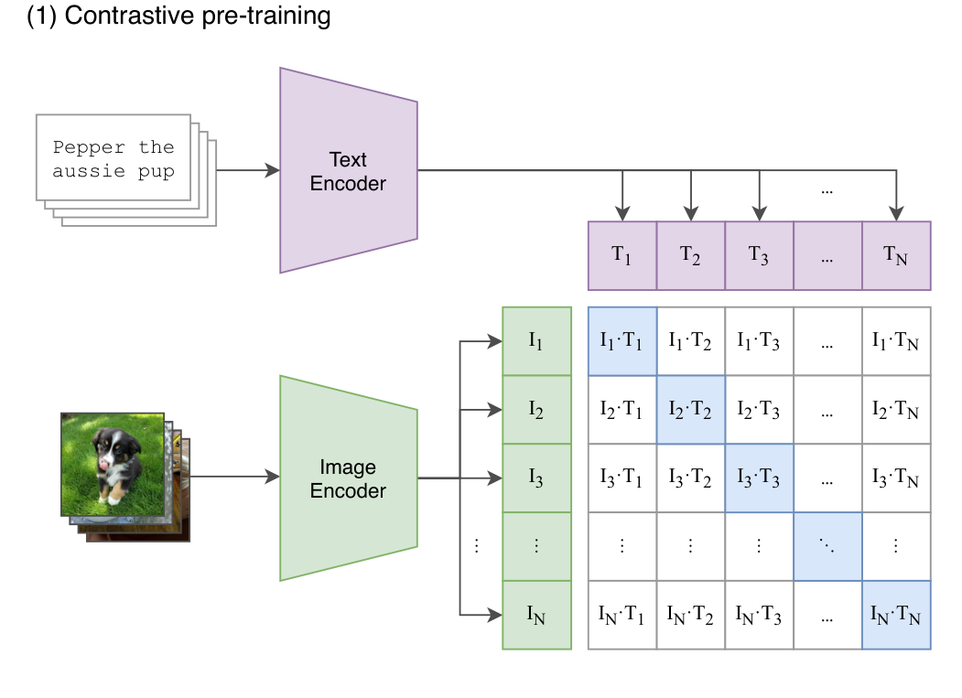
THE BUILDING BLOCK
One shared space for pictures and sentences
Contrastive pretraining
CLIP trains an image encoder and a text encoder together on hundreds of millions of (image, caption) pairs, pulling matching pairs together and pushing mismatched pairs apart in one shared embedding space.
Why VLA models inherit this
Once images and text live in the same space, a sentence can steer what the model attends to in a picture: “the red mug” selects a region without any hand-written rule. This is the mechanism VLA models lean on for language conditioning: swap the instruction, and the same image drives a different action, because the language moved where attention lands.
Radford et al. (2021), Learning Transferable Visual Models From Natural Language Supervision, arXiv:2103.00020, Figure 1(1).
Session 40 · Vision-Language-Action Models

Slide 8
TELLING THEM APART
A VLM describes the world. A VLA changes it.
VISION-LANGUAGE MODEL
VISION-LANGUAGE-ACTION MODEL
Input
Image and text (and often a chat history)
Image, text, and usually proprioception: joint angles, gripper state
Output
More text: a caption, an answer, a plan in words
A control command: joint deltas, end-effector pose, or a gripper signal
Runs as
One shot, or a back-and-forth conversation
A closed loop, re-issuing actions many times a second
Judged by
How accurate or helpful the text is
Whether the task actually gets done in the physical world
The grey area: a system that uses a VLM to pick from a fixed menu of skills (SayCan-style) sits between the two, more on that in a few slides.
Session 40 · Vision-Language-Action Models

Slide 9
THE BIG PICTURE
One loop, running many times a second
Observe
Understand
Act
Move
Camera image(s)
+ proprioception
VLA model reads
image + instruction
Emits the next
action (chunk)
Robot executes,
world changes
closed loop: the next observation already reflects the last action
Frequency is a design choice
RT-1 re-plans at 3 Hz; GR00T N1's fast action module runs at 120 Hz. Slower loops need longer, smoother action chunks per step; faster loops can react sooner but cost more compute per second.
Session 40 · Vision-Language-Action Models

Slide 10
BUILDING BLOCKS · 1 OF 4
The vision encoder: turning pixels into tokens
Patchify, then embed
Which encoder, in practice
The image is cut into a grid of small patches (a Vision Transformer, ViT, typically uses 16x16 pixel patches). Each patch is flattened and projected into a vector, so a 224x224 image becomes a sequence of a few hundred “visual tokens”, the same kind of object a language model expects as input. This is visual tokenization: the bridge that lets a single transformer read images and text side by side.
CLIP ViT (language-aligned, used since RT-2), SigLIP (a stronger contrastive variant), and DINOv2 (self-supervised, very sensitive to spatial detail). OpenVLA fuses SigLIP and DINOv2 together for both semantics and precise geometry.
Why it matters for control
A captioning model can get away with coarse features. A robot cannot: it needs to know precisely where the mug's handle is, not just that a mug is present. This is why VLA vision encoders are chosen and sometimes fine-tuned for spatial precision, not just recognition.
Session 40 · Vision-Language-Action Models

Slide 11
BUILDING BLOCKS · 2 OF 4
The language backbone: borrowed knowledge, not built from scratch
The core move of modern VLA design
Instead of training a robot policy from zero, start from a language or vision-language model that has already read a huge slice of the internet: PaLI-X and PaLM-E for RT-2, Llama 2 7B for OpenVLA. The robot-specific training then adapts that backbone rather than replacing it.
What it contributes
What it costs
How VLAs adapt it
Semantic knowledge: what a whisk is for, that a rock can serve as a hammer, what “near” versus “on” means.
Billions of parameters built for language, now asked to also emit precise, low-level numbers, which is not their native job.
Fine-tuning (often parameter-efficient, e.g. LoRA) so the backbone keeps its knowledge while learning to end sentences in actions.
Session 40 · Vision-Language-Action Models

Slide 12
BUILDING BLOCKS · 3 OF 4
Multimodal fusion: getting vision and language to talk
Early fusion / token concatenation
Visual tokens and language tokens are simply placed in the same sequence and fed through one transformer together.
RT-2, OpenVLA
Feature-wise conditioning (FiLM)
Language features rescale and shift the vision network's activations layer by layer, steering perception before fusion even finishes.
RT-1
Cross-attention between systems
A fast action module cross-attends into a slower vision-language module's output tokens, rather than sharing one sequence.
GR00T N1
Session 40 · Vision-Language-Action Models

Slide 13
BUILDING BLOCKS · 4 OF 4
The action decoder: where a plan finally becomes a number
The one part vision-language models never needed
A VLM's decoder predicts the next word. A VLA's action decoder has to predict something a motor controller can execute, right now, at the right physical scale. Three families dominate current designs, and the rest of this section works through each one.
Discrete tokens
Continuous regression
Diffusion / flow matching
Bin each action dimension (often 256 bins) and predict bin IDs like words.
An MLP head maps hidden features straight to real-valued actions.
Iteratively denoise a sample into a smooth, multi-modal action.
Next: we open each of these up, with the models that made them popular.
Session 40 · Vision-Language-Action Models

Slide 14
PUTTING IT TOGETHER
The same picture, a different instruction, a different action
Scene: an arm over a table with a red mug and a blue mug
Same vision tokens, different conditioning
“Pick up the red mug”
“Pick up the blue mug”
“Push the red mug toward the blue one”
Three different action sequences come out, aimed at three different points in the same image, because language conditioning changes which pixels the policy attends to and what it does once it gets there.
Language conditioning, precisely
Every component you just saw exists to make this possible: a vision encoder that preserves “where”, a language backbone that understands “which one and what to do”, a fusion mechanism that lets language re-weight what vision reports, and an action decoder that turns the fused representation into a trajectory. Policy learning, in this framing, is just learning the function from (image, instruction, robot state) to action, end to end, from data, rather than writing that function by hand for every case.
Session 40 · Vision-Language-Action Models

Slide 15
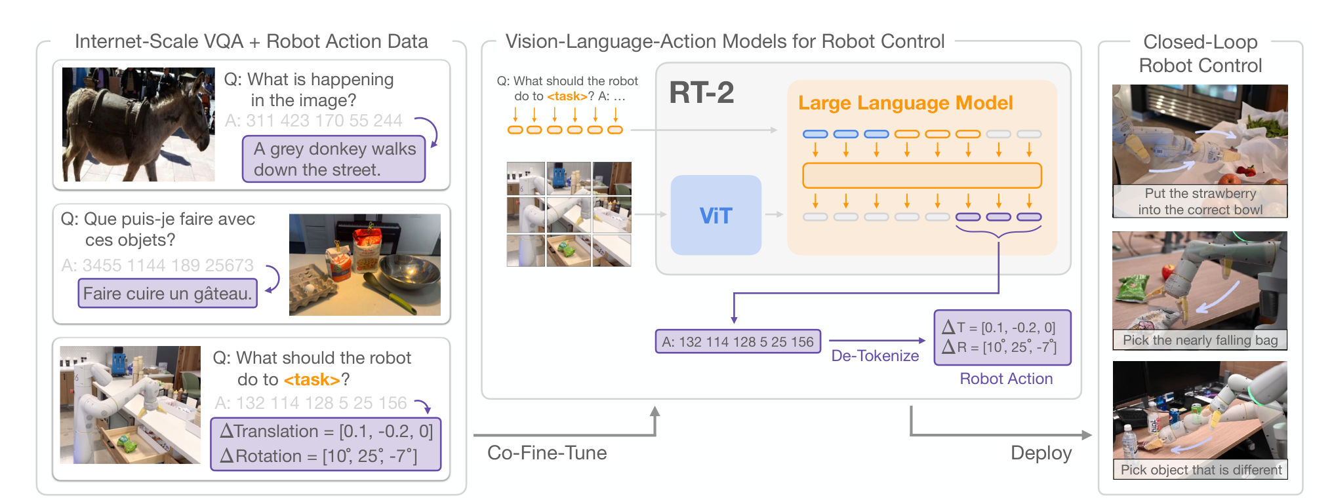
ACTION REPRESENTATION · DISCRETE
Treat an action like one more word in the sentence
The trick
Split each of the 8 action numbers (3D position, 3D rotation, gripper, terminate) into 256 bins, and write the bin IDs as a short string: “132 114 128 5 25 156”. Now an action is just text.
Why that's clever
The model needs no new output head: it reuses the same tokenizer and next-token prediction loss it already had for language, which is exactly what let RT-2 train on web data and robot data together.
Zitkovich et al. (2023), RT-2: Vision-Language-Action Models Transfer Web Knowledge to Robotic Control, arXiv:2307.15818, Figure 1.
Session 40 · Vision-Language-Action Models

Slide 16
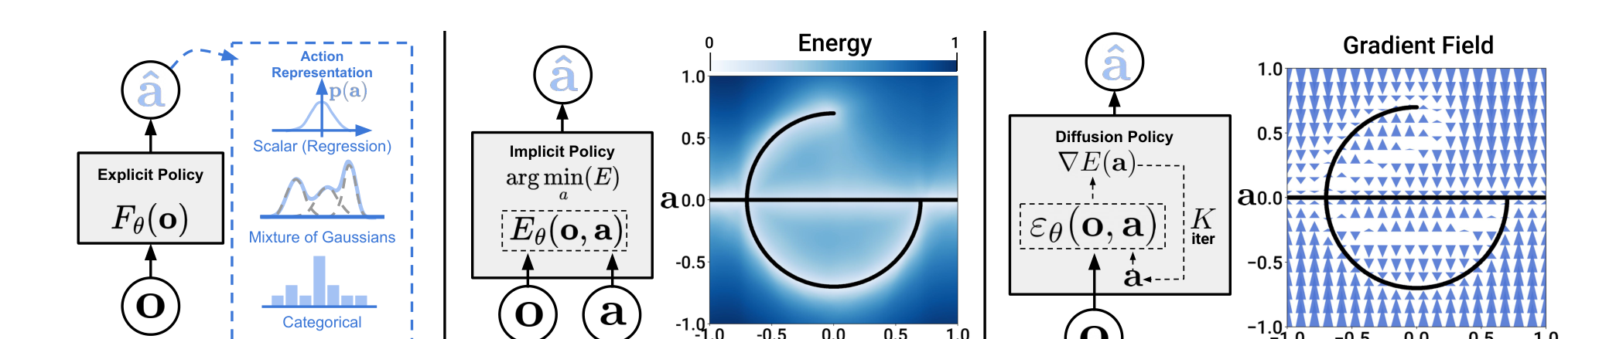
ACTION REPRESENTATION · CONTINUOUS
When there is more than one right answer
Chi et al. (2023/2024), Diffusion Policy: Visuomotor Policy Learning via Action Diffusion, arXiv:2303.04137, Figure 1.
The problem binning and regression share
The diffusion / flow-matching fix
Go around an obstacle left or right: both work, but the average of the two goes straight through it. A single discrete token or a single regressed vector cannot represent “two good options”, only one blurred, bad one.
Start from noise and iteratively refine it toward a plausible action, conditioned on the scene. This models the full distribution of good actions, not just its average. Flow matching (used by pi-0) reaches the same goal with a straighter, faster path than diffusion's many small denoising steps.
Session 40 · Vision-Language-Action Models

Slide 17
ACTION REPRESENTATION · CHUNKING
Predict a short future, not just the next instant
Without chunking: one action per model call
a₁
a₂
a₃
a₄
a₅
a₆
With chunking: predict k actions at once, then re-plan
a₁
a₂
a₃
a₄
a₅
a₆
← one chunk, one forward pass
Why it helps
Action Chunking with Transformers (ACT)
Predicting k steps ahead shrinks the effective planning horizon by a factor of k, which is exactly where imitation learning's compounding errors bite hardest. It also produces smoother motion than re-deciding from scratch every instant.
Zhao, Kumar, Levine & Finn's ACT policy (used with the ALOHA rig) predicts chunks of 90 actions at 50 Hz, then blends overlapping chunks (temporal ensembling) for smoothness. Result: 80–90% success on fine manipulation from just 50 demonstrations, about 10 minutes of data collection.
Session 40 · Vision-Language-Action Models

Slide 18
PUTTING THE PIECES IN MOTION
A policy is just a learned function you keep calling
Policy learning, defined
A policy π(action | observation, instruction) maps what the robot currently perceives and is asked to do, to what it should do next. “Learning the policy” means fitting that function's parameters from data, rather than programming it rule by rule.
Open loop
Closed loop
Compute a plan once, then execute it blindly to the end. Fast, but any small error or bump compounds with nothing to correct it.
Re-observe after every action or chunk, and re-plan from the new state. Slower per step, but self-correcting, which is what almost every real VLA does.
Behavioral cloning, the default way to fit π
Treat the demonstrations as (observation, action) pairs and train the policy with ordinary supervised learning: minimise the distance between the model's predicted action and the action the human actually took. It is simple, stable, and exactly what almost every VLA we'll name tonight starts from.
Session 40 · Vision-Language-Action Models

Slide 19
HOW VLA MODELS ARE TRAINED
Four stages, not always all used, rarely used alone
1. Collect
2. Pretrain
3. Fine-tune
4. Deploy (+RL)
Human demonstrations via teleoperation, plus web and video data
Internet-scale vision-language data + broad cross-embodiment robot data
Adapt to your robot, workspace and tasks; often parameter-efficient
Run closed loop; occasionally refine further with reinforcement learning
The honest version
In practice these blur together: pi-0.5 calls its recipe co-training, mixing demonstration data, web data and semantic labels in one training run rather than strict sequential stages. The four-stage picture is a teaching device; treat it as a checklist of ingredients a serious VLA recipe needs, not a rigid order every model follows. We'll walk through each ingredient on the next few slides.
Session 40 · Vision-Language-Action Models

Slide 20
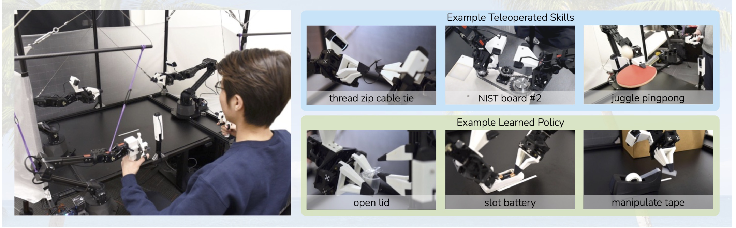
STAGE 1 · DEMONSTRATIONS
Someone has to show the robot what to do, first
Teleoperation
A human backdrives a leader arm; a follower arm mirrors the motion while cameras and joint encoders log (observation, action) pairs. ALOHA does this for under $20,000 in hardware.
Expensive, but the ground truth
Every demonstration needs a person, in the loop, in real time. It doesn't scale like internet text does, which is precisely why pretraining tries to borrow as much as possible from data that isn't a teleoperated demonstration: web images, human videos, other robots' logs.
Zhao, Kumar, Levine & Finn (2023), Learning Fine-Grained Bimanual Manipulation with Low-Cost Hardware, arXiv:2304.13705, Figure 1.
Session 40 · Vision-Language-Action Models

Slide 21
STAGE 1 CONTINUED · LEARNING FROM DEMOS
Small errors, uncorrected, become big ones
The compounding error problem
Behavioral cloning only ever sees states a competent demonstrator visited. The moment the learned policy drifts even slightly off that distribution, it enters territory it never trained on, makes a worse decision, drifts further, and the error snowballs.
start
tiny
error
off-
distribution
worse
decision
task
fails
How today's VLAs push back on this
Action chunking shortens the horizon between re-plans. Temporal ensembling smooths across overlapping chunks. Training on more diverse trajectories, including some recoveries and near-misses, teaches the policy what to do when it isn't perfectly on track. None of these fully solve the problem, which is why it resurfaces later as an open research direction.
Session 40 · Vision-Language-Action Models

Slide 22
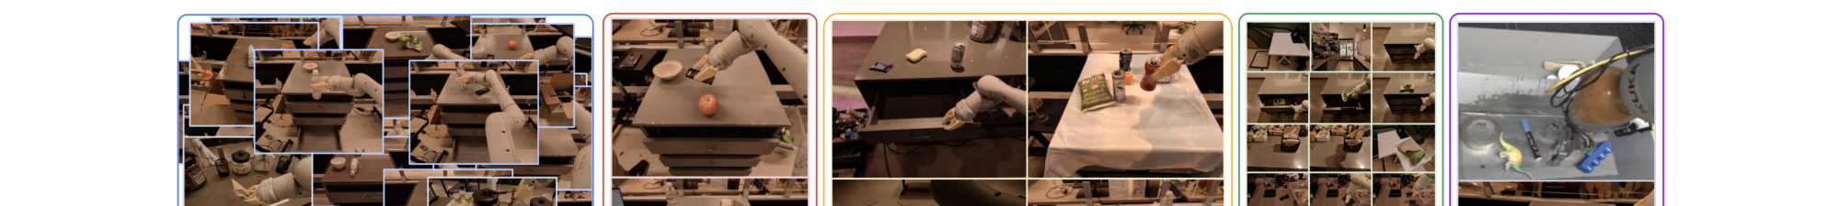
STAGE 2 · PRETRAINING
Breadth first, specialise later
Brohan et al. (2022), RT-1: Robotics Transformer for Real-World Control at Scale, arXiv:2212.06817, Figure 1(b).
Co-fine-tuning on web + robot data
Cross-embodiment pretraining
RT-2 trains on internet vision-question-answering data and robot trajectories in the same run, so the model never has to “forget” its web knowledge to learn actions; the two objectives are optimised together.
Rather than pretrain on one robot, pool trajectories from many robots and labs (Open X-Embodiment, pi-0's cross-embodiment dataset). A policy that has already seen many bodies adapts to a new one with far less task-specific data.
Session 40 · Vision-Language-Action Models

Slide 23
STAGE 3 · ADAPTING TO YOUR ROBOT
You rarely need to move all the weights
Full fine-tuning
Parameter-efficient (LoRA)
Efficient post-training
Update every parameter on your task's data. Strongest ceiling, most compute and most demonstrations needed.
Freeze the backbone, train small low-rank adapters. OpenVLA matches full fine-tuning while touching only 1.4% of parameters.
pi-0.5-style: a short, targeted round of high-quality data for one new skill, on top of an already broad base policy.
Efficiency at serving time, too
OpenVLA's team also showed a 7B-parameter VLA can be served quantized on a single consumer GPU without losing success rate, which is what separates “a model that works in a paper” from “a model you can actually run next to the robot”. Fine-tuning strategy and deployment footprint end up being the same conversation in practice.
Session 40 · Vision-Language-Action Models

Slide 24
STAGE 4 (SOMETIMES) · REINFORCEMENT LEARNING
Today's VLAs mostly imitate; RL is the frontier
Why imitation learning still dominates
Reinforcement learning needs a reward signal and many trial-and-error attempts. On a physical robot that's slow, it wears out hardware, and a bad exploratory action can be unsafe. Behavioral cloning sidesteps all three problems by learning directly from successful human demonstrations.
Where RL shows up today
A frontier, not a fixture
The practical middle ground
Refining a policy past the demonstrator's own skill ceiling; simulation-based RL, then transferred to the real robot.
The IEEE Access survey names “moving beyond pure behavioral cloning” toward RL integration as an open future direction, not settled practice.
Preference-based fine-tuning and automated success/failure labelling let some RL-flavoured signal in without full trial-and-error on hardware.
Session 40 · Vision-Language-Action Models

Slide 25
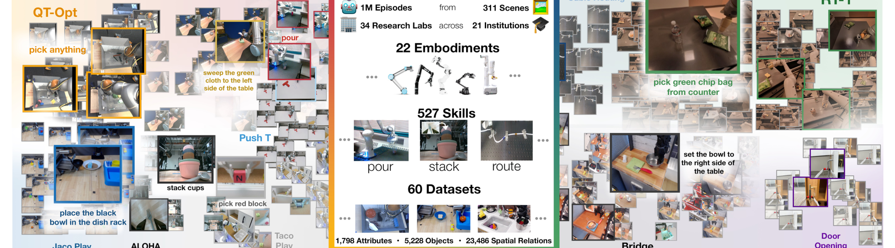
SCALE
Robot data is nowhere near web-scale, and that's the point
Open X-Embodiment, by the numbers
21 institutions pooled 60 existing datasets into over 1 million trajectories across 22 robot embodiments and 527 distinct skills, the largest open cross-robot dataset to date.
Still small, next to vision
CLIP trained on hundreds of millions of images. The biggest robot manipulation datasets sit at 100k to 1M examples. That three-to-four-order-of-magnitude gap is the field's central constraint.
O'Neill et al. (2023), Open X-Embodiment: Robotic Learning Datasets and RT-X Models, arXiv:2310.08864, Figure 1.
Session 40 · Vision-Language-Action Models

Slide 26
DATA REQUIREMENTS
Four datasets that shaped the field
Dataset
Scale
What it added
RT-1 dataset
130k episodes, 13 robots, 17 months
First demonstration that a single transformer policy generalises across a large, diverse, single-embodiment kitchen dataset.
Open X-Embodiment
1M+ trajectories, 22 embodiments, 527 skills
Pooled 60 labs' datasets into one cross-embodiment corpus, enabling RT-X and OpenVLA-style pretraining.
DROID
76k demonstrations, 564 scenes, 86 tasks
Diverse, in-the-wild homes and offices rather than a single lab, targeting real-world visual variety.
BridgeData
Tens of thousands of trajectories, low-cost arms
Widely reused benchmark for evaluating generalisation on affordable hardware, common in academic VLA papers.
Session 40 · Vision-Language-Action Models

Slide 27
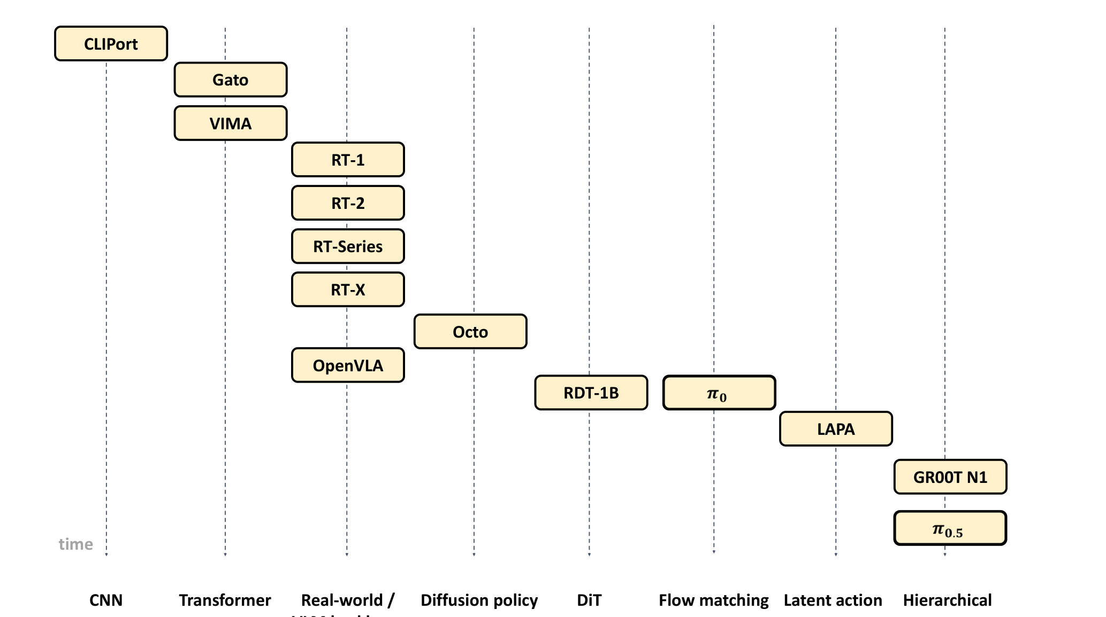
THE LANDSCAPE
The field's timeline, from one 2025 survey
Kawaharazuka, Oh, Yamada, Posner & Zhu (2025), IEEE Access, arXiv:2510.07077, Figure 2 (“Timeline of major VLA models”).
Session 40 · Vision-Language-Action Models

Slide 28
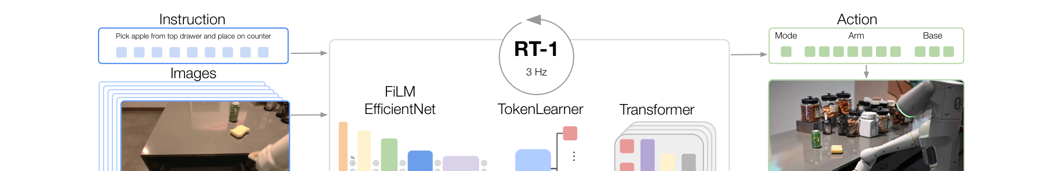
WELL-KNOWN SYSTEMS · 1
RT-1 and RT-2: from a robot transformer to a web-scale one
Brohan et al. (2022), RT-1: Robotics Transformer for Real-World Control at Scale, arXiv:2212.06817, Figure 1(a).
RT-1 (2022)
RT-2 (2023)
A compact transformer trained end-to-end on 130k robot demonstrations, tokenizing images and actions together. Runs at 3Hz, fast enough for closed-loop control, and became the backbone architecture the rest of the field iterated on.
Takes a web-pretrained vision-language model and co-fine-tunes it on the same kind of robot data, representing actions as text tokens. Inherits internet-scale semantic knowledge, so it can follow instructions about objects never seen in robot demonstrations.
Session 40 · Vision-Language-Action Models

Slide 29
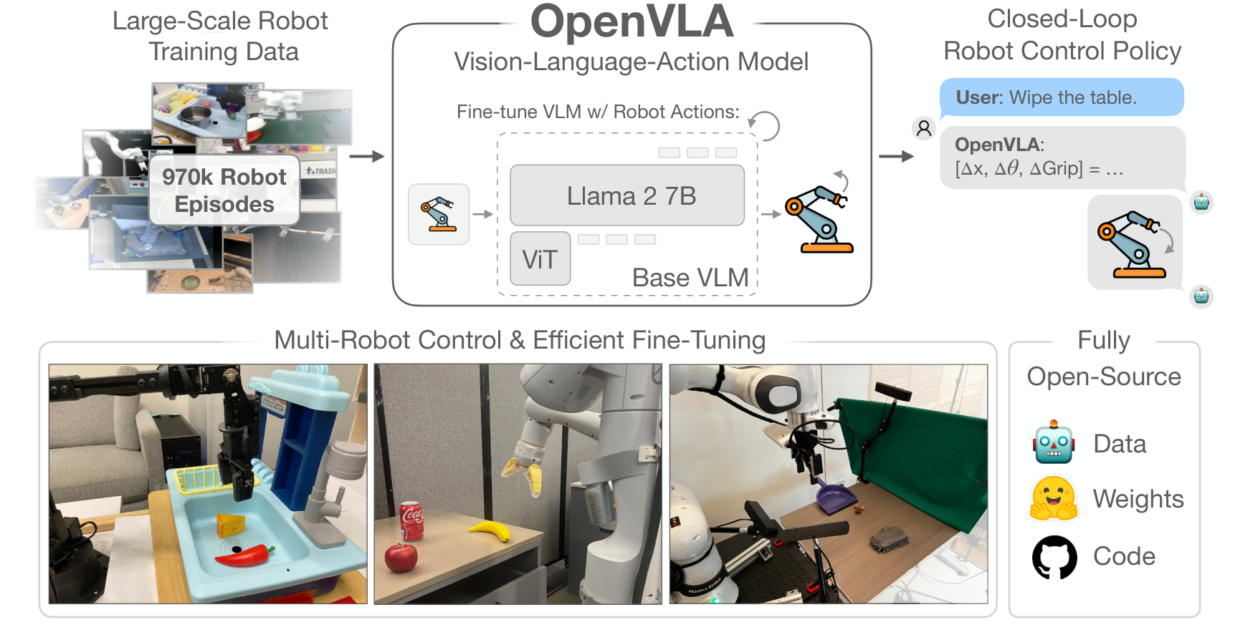
WELL-KNOWN SYSTEMS · 2
OpenVLA: an open recipe the field could build on
7B parameters, fully open
SigLIP + DINOv2 visual features feeding a Llama 2 7B backbone, trained on 970k Open X-Embodiment episodes. Open weights, open training code, unlike RT-2.
Why it mattered
Matched or beat RT-2-X (55B parameters) on real-robot generalisation tasks at a fraction of the size, and showed LoRA fine-tuning on a new robot could match full fine-tuning at 1.4% of the trainable parameters. It became a common baseline other papers fine-tune from.
Kim, Pertsch, Karamcheti et al. (2024), OpenVLA: An Open-Source Vision-Language-Action Model, arXiv:2406.09246, Figure 1.
Session 40 · Vision-Language-Action Models

Slide 30
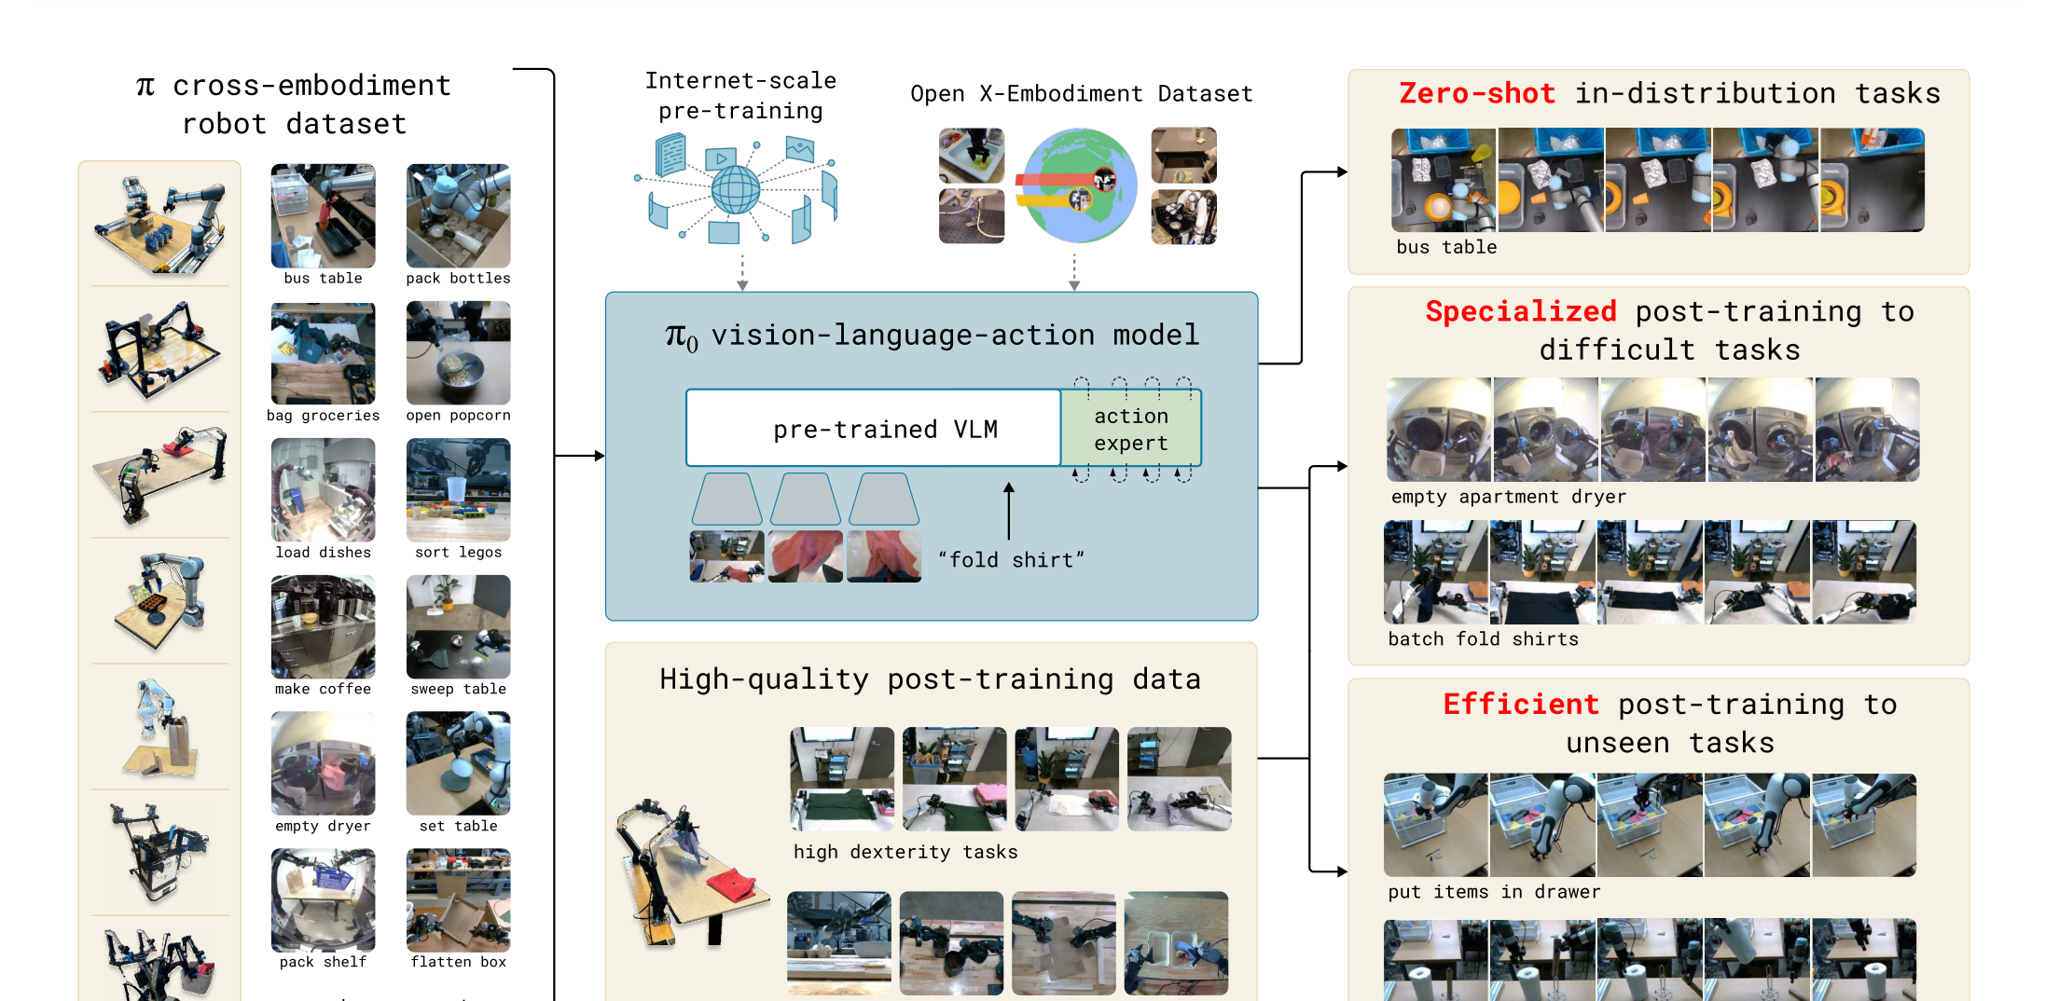
WELL-KNOWN SYSTEMS · 3
pi-0 and pi-0.5: flow matching for dexterous, long tasks
Flow matching, not diffusion
Generates continuous, high-frequency action chunks by flow matching rather than step-by-step denoising, aimed at contact-rich tasks like folding laundry.
pi-0.5: co-training for the home
The follow-up adds heterogeneous co-training (web data, other robots' data, and a smaller amount of target-home data together) so the policy generalises to homes never seen during training, not just objects.
Black et al., Physical Intelligence (2024), pi_0: A Vision-Language-Action Flow Model for General Robot Control, arXiv:2410.24164, Figure 1.
Session 40 · Vision-Language-Action Models

Slide 31
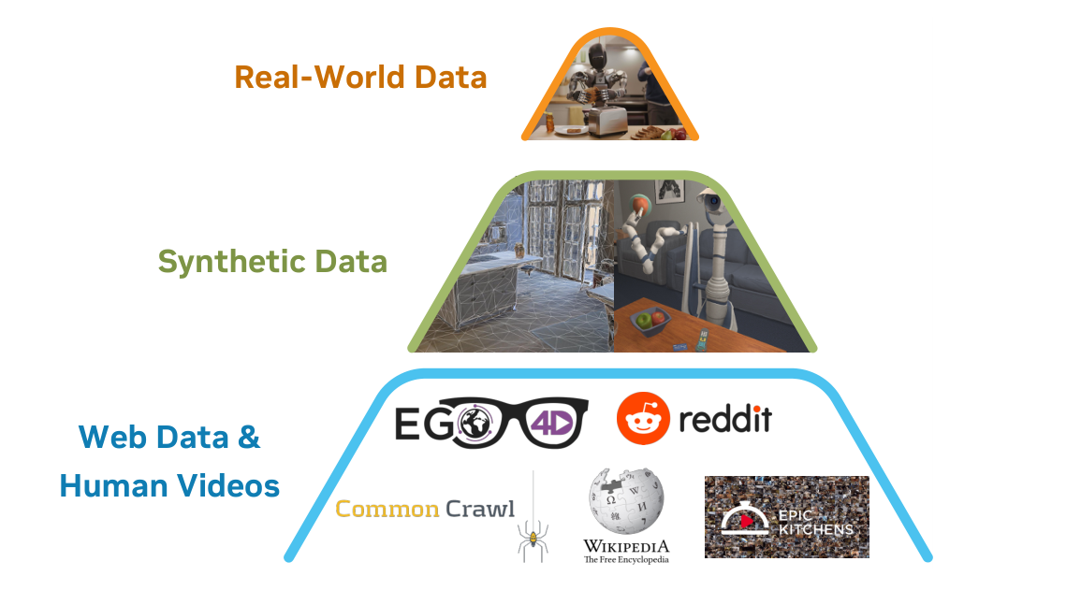
WELL-KNOWN SYSTEMS · 4
GR00T N1: a foundation model for humanoids
A dual-system architecture
A slower vision-language “system 2” for reasoning about the scene and instruction, paired with a fast diffusion-based “system 1” action head, cross-attention connecting the two, running at up to 120Hz.
The data pyramid
Built on a broad base of web data and human videos, a middle layer of simulated and synthetically generated robot data, and a small top layer of real humanoid teleoperation data, deliberately using the cheapest data where it can and the most expensive only where it must.
NVIDIA (2025), GR00T N1: An Open Foundation Model for Generalist Humanoid Robots, arXiv:2503.14734, Figure 1.
Session 40 · Vision-Language-Action Models

Slide 32
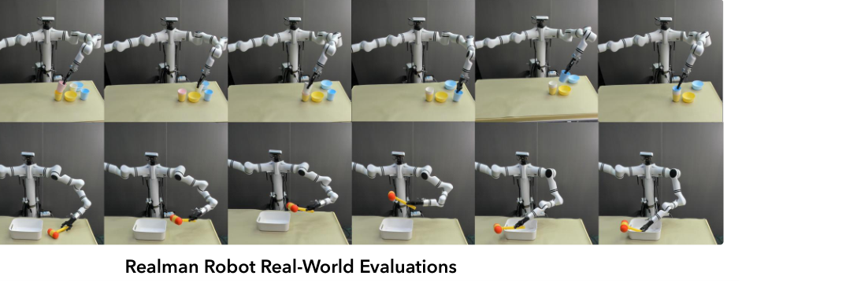
WELL-KNOWN SYSTEMS · 5
CogACT, and the wider field
CogACT
Separates “what to do” (a VLM) from “how to move” (a dedicated diffusion action module), arguing this split outperforms bolting a simple action head onto a VLM.
Li et al. (2024), CogACT: A Foundation Model for Vision-Language-Action Modeling, arXiv:2411.19650, Figure 1(c).
Octo
An open, transformer-based generalist policy trained across many embodiments, designed to be easy to fine-tune to a new robot with a small amount of data.
Real-world grounding
CogACT was evaluated on a real Realman arm, not just in simulation. The strip above shows two full task rollouts, picking and placing small objects, frame by frame, which is the standard way robotics papers demonstrate a policy actually works on hardware.
SayCan and the earlier bridge
Paired an LLM's task-planning with a robot's learned skills before end-to-end VLAs existed, shown in more detail two slides ahead.
Session 40 · Vision-Language-Action Models

Slide 33
RECAP
The models this session has walked through
Model
Year
Signature idea
RT-1
2022
Compact transformer, 130k demos, real-time control
RT-2
2023
Web-pretrained VLM co-fine-tuned, actions as text tokens
Open X-Embodiment / RT-X
2023
Cross-embodiment data pooling at scale
OpenVLA
2024
Open 7B model matching much larger closed ones
ACT (ALOHA)
2023
Action chunking for bimanual manipulation from ~50 demos
Diffusion Policy
2023
Generative modelling of the full action distribution
pi-0 / pi-0.5
2024
Flow matching plus heterogeneous co-training
GR00T N1
2025
Dual-system humanoid foundation model
CogACT
2024
Separate VLM cognition and diffusion action modules
Session 40 · Vision-Language-Action Models

Slide 34
IN CONTEXT · 1
VLA versus the classical robotics pipeline
TRADITIONAL PIPELINE
VLA PIPELINE
Perception
(object detection, pose estimation)
One learned model
State estimation
(where is everything, exactly)
Perception, state understanding, planning and control are folded into a single network trained end-to-end on demonstrations. There is no explicit object detector or motion planner to hand-tune; the mapping from pixels and words to motor commands is learned directly.
Planning
(motion or task planner)
What used to be four separately engineered modules becomes one training data problem: collect enough good demonstrations and the split between stages disappears.
Control
(low-level motor commands)
Each stage hand-engineered and separately tuned
Fewer hand-tuned stages, but a black box to debug
Session 40 · Vision-Language-Action Models

Slide 35
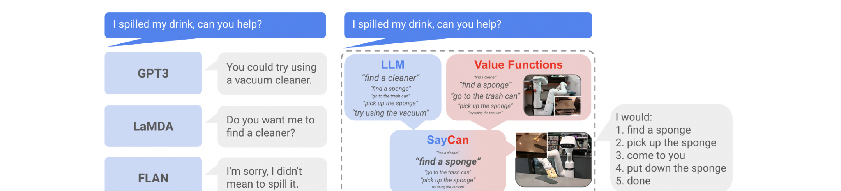
IN CONTEXT · 2
VLA, VLM, and LLM agents are not the same thing
Ahn et al. (2022), Do As I Can, Not As I Say: Grounding Language in Robotic Affordances, arXiv:2204.01691, Figure 1.
A VLM
An LLM agent
A VLA
Describes or answers questions about an image and text. No robot, no action output.
Plans and calls tools or APIs in text space. SayCan is the bridge case: an LLM plans in language, then hands each step to a separately-trained robot skill.
Skips the hand-off. One model takes pixels and language in and produces motor commands out, trained end-to-end rather than composed from separate pieces.
Session 40 · Vision-Language-Action Models

Slide 36
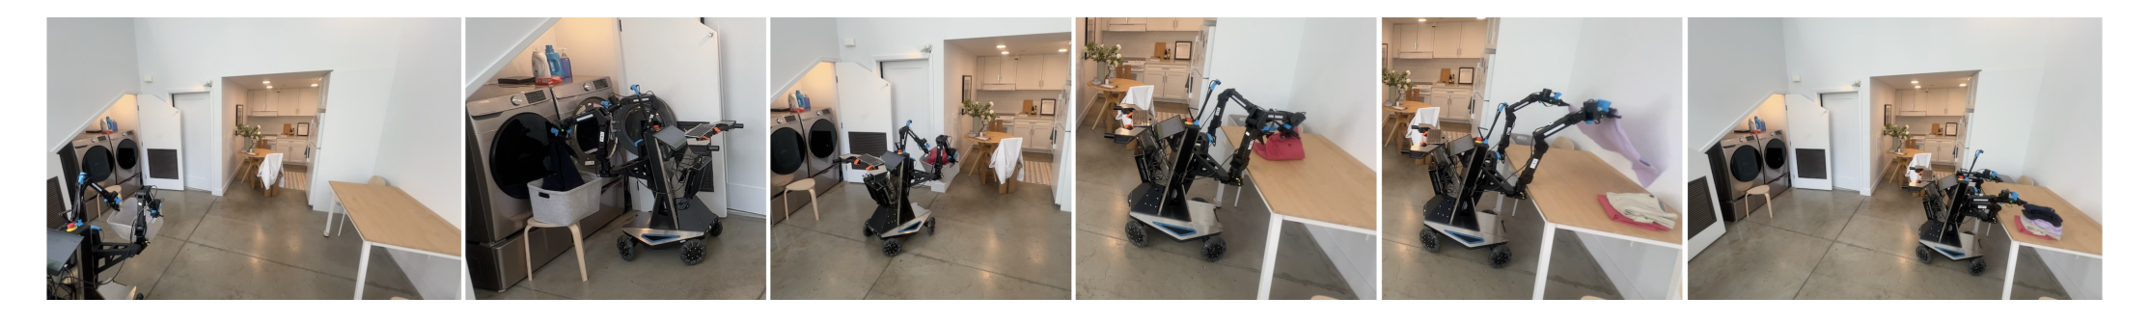
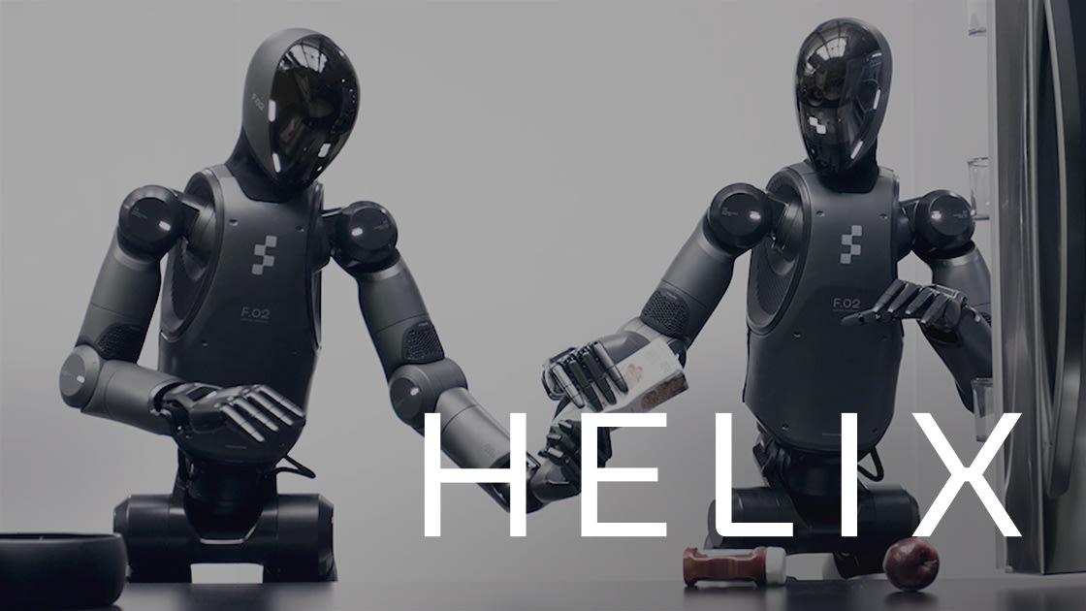
APPLICATIONS
Where VLA models are already being deployed
Black et al., Physical Intelligence (2024), arXiv:2410.24164, Figure 2.
Also emerging in
Warehouse pick-and-place, kitchen and food-service robots, assistive and eldercare manipulation, and general-purpose humanoid platforms across logistics and light manufacturing. pi-0's laundry-folding run above is a good proxy for the field's current frontier: long, contact-rich, everyday tasks in unstructured home environments rather than the controlled factory floor.
Figure AI (2025), Helix, official product page, figure.ai/news/helix.
Two Figure robots coordinating a handoff, driven end-to-end by a VLA policy.
Session 40 · Vision-Language-Action Models

Slide 37
CHALLENGES
Seven open problems, from data to deployment
1
Data scarcity: three to four orders of magnitude less data than vision or language models had
2
Generalization: to new objects, scenes, and instructions beyond the training distribution
3
Latency: reasoning-heavy models must still act inside a tight control loop
4
Safety: a physical mistake can hurt people, unlike a wrong sentence from a chatbot
5
Sim-to-real: skills learned in simulation must survive real physics and real sensor noise
6
Embodiment: a policy trained on one robot's body does not automatically transfer to another
7
Long-horizon tasks: chaining many correct steps without one early error derailing the rest
Session 40 · Vision-Language-Action Models

Slide 38
CHALLENGES, CLOSER UP · 1
Data, generalization, and the embodiment gap
Data scarcity
Generalization
Embodiment differences
Collecting a single robot demonstration takes a human teleoperator minutes, not the milliseconds it takes to scrape a captioned web image. Every dataset in this session, even pooled together, is still small next to what trained CLIP or GPT-style models.
A policy trained on red mugs on a wooden table can fail on a blue mug on a marble counter, even though the task is identical. Web-pretrained vision and language backbones help, but the action side of the model is still trained on a comparatively narrow slice of the world.
A gripper, a five-fingered hand, and a suction cup need different actions for the same goal. Cross-embodiment datasets like Open X-Embodiment help a model see many robot bodies during training, but transferring cleanly to a truly new robot remains unsolved in general.
Why it matters most
The gap that remains
One open question
Everything downstream, generalization, robustness, even RL, is bottlenecked on having enough good demonstrations to learn from in the first place.
Semantic generalization (naming new objects) has improved fast; physical generalization (new shapes, weights, frictions) lags further behind.
Whether a single shared action space can ever cover wheels, legs, and hands, or whether each embodiment family needs its own decoder.
Session 40 · Vision-Language-Action Models

Slide 39
CHALLENGES, CLOSER UP · 2
Latency, safety, sim-to-real, and long horizons
Latency
Safety
A large vision-language backbone can take hundreds of milliseconds to think. Action chunking and dual-system designs (like GR00T N1) exist precisely to keep the loop fast enough for real control.
An unsafe action on hardware can damage the robot, the environment, or a person, and mistakes are not easily undone. This raises the bar for testing and monitoring far above a text-only model.
Sim-to-real
Long-horizon tasks
Physics engines and rendered images never perfectly match the real world's friction, lighting, and sensor noise, so skills that work in simulation can degrade when moved to a physical robot.
Making a sandwich or unloading a dishwasher takes dozens of correct steps in sequence. A small per-step error rate compounds quickly across a long task, per the drift problem shown earlier.
Session 40 · Vision-Language-Action Models

Slide 40
WHERE RESEARCH IS HEADED
Eight directions the field is actively pushing on
Better action representations: richer than discrete tokens, cheaper than full diffusion
More efficient architectures for on-robot, real-time inference
Moving beyond pure behavioral cloning toward RL-integrated training
Better evaluation and benchmarking standards across labs
World models that let a policy imagine consequences before acting
Scaling laws for robot data, mirroring what vision and language established
Improved cross-embodiment transfer and shared action spaces
Safety, uncertainty estimation, and failure detection built into the policy itself
Session 40 · Vision-Language-Action Models

Slide 41
LOOKING AHEAD
From narrow demos to general-purpose embodied assistants
The trajectory so far
Three years took the field from a single robot picking known objects in a lab (RT-1) to open, cross-embodiment foundation models (OpenVLA, GR00T N1) and humanoids folding laundry in a home it has never seen (pi-0.5). The pace, not any single result, is the headline.
Foundation models for robots
Humanoids as a platform bet
Convergence with reasoning
The same pretrain-then-adapt recipe that reshaped language and vision is now being applied to action, with cross-embodiment data playing the role web text played for LLMs.
Several labs are betting that a human-shaped body, trained on human-shaped data (video, teleoperation), is the fastest path to a general-purpose physical assistant.
Expect tighter coupling between large reasoning models and fast action modules, so a robot can plan, explain itself, and act inside the same system.
Session 40 · Vision-Language-Action Models

Slide 42
SUMMARY
Key takeaways
What
A VLA model turns pixels and words directly into motor commands, in one trained network, closing the loop that used to run through separate perception, planning and control stages.
How
A vision encoder and a language backbone share a common token space; an action decoder, discrete, continuous, or diffusion-based, turns that shared representation into a chunk of future motion.
Trained on
Human or teleoperated demonstrations, mostly through imitation learning, pretrained broadly on cross-embodiment data and then fine-tuned narrowly, with reinforcement learning still an emerging frontier.
Still hard
Data scarcity, generalization, embodiment transfer, latency, safety, sim-to-real gaps, and long-horizon tasks all remain open, active research problems, not solved ones.
The lineage runs from seeing, to seeing and understanding, to seeing, understanding, and acting. That last step is still being written.

